Slide 1
Outreach on the Streets
Kaimbrea Vance (PIC) , Jenny Neal (CORE), Castro Masaniai (IHS), Austin Ajimura & Dr. Teresa Schiff-Elfalan(HOME Project)

Slide 2
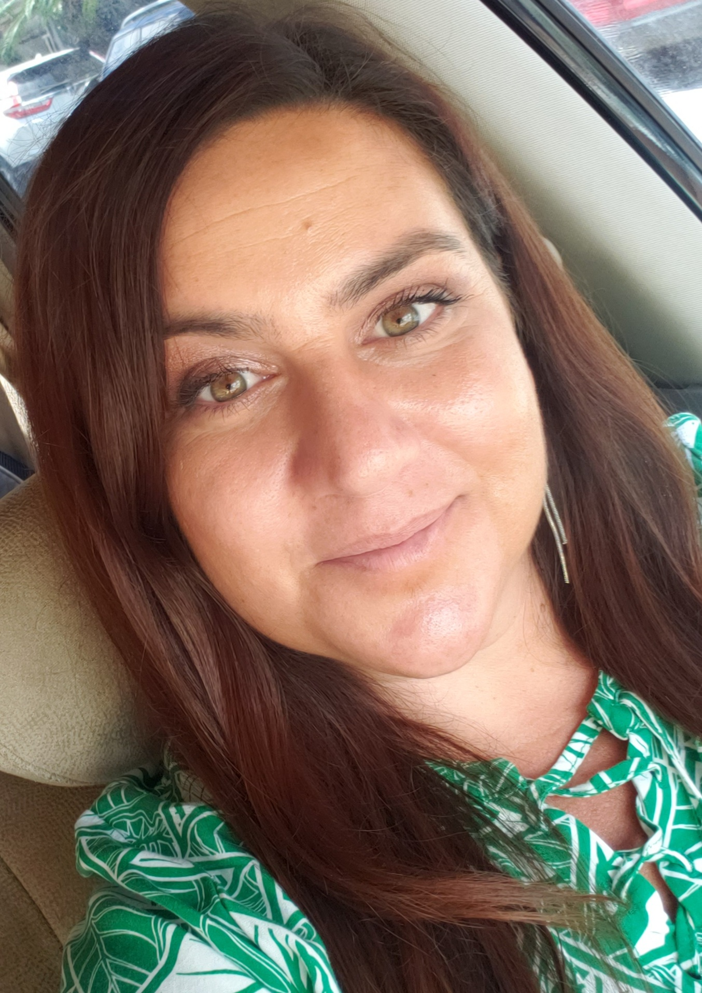
Kaimbrea Vance Partners in Care Landlord Engagement Program

Slide 3
Homeless at the Ala Wai Boat Harbor in 2014 with Uncle Clarence

Slide 4
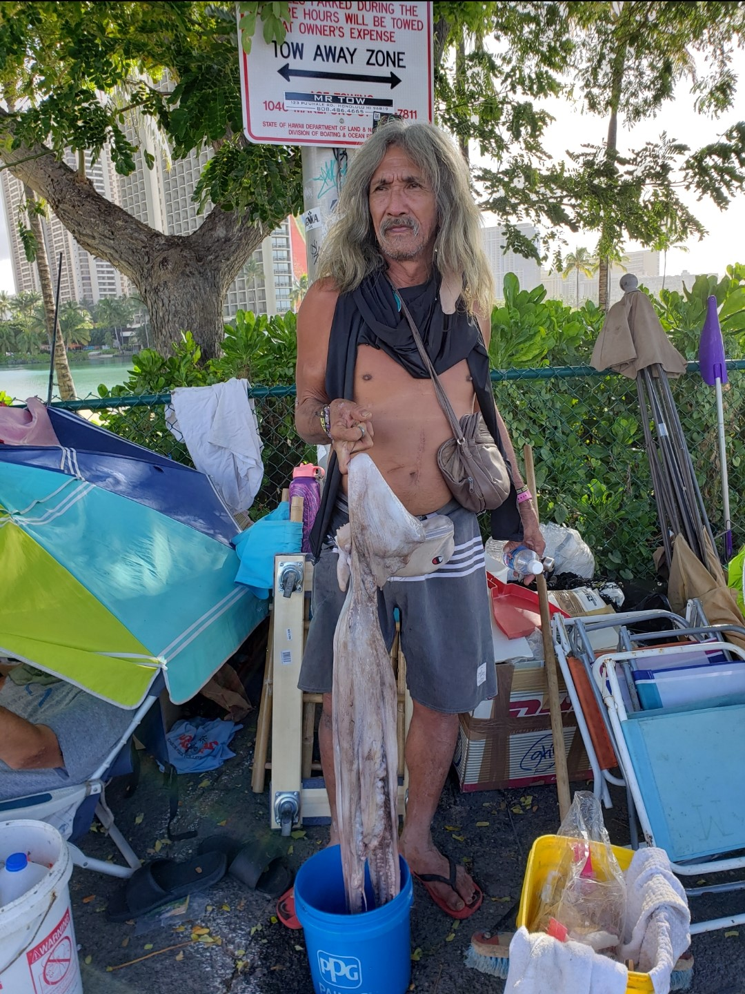
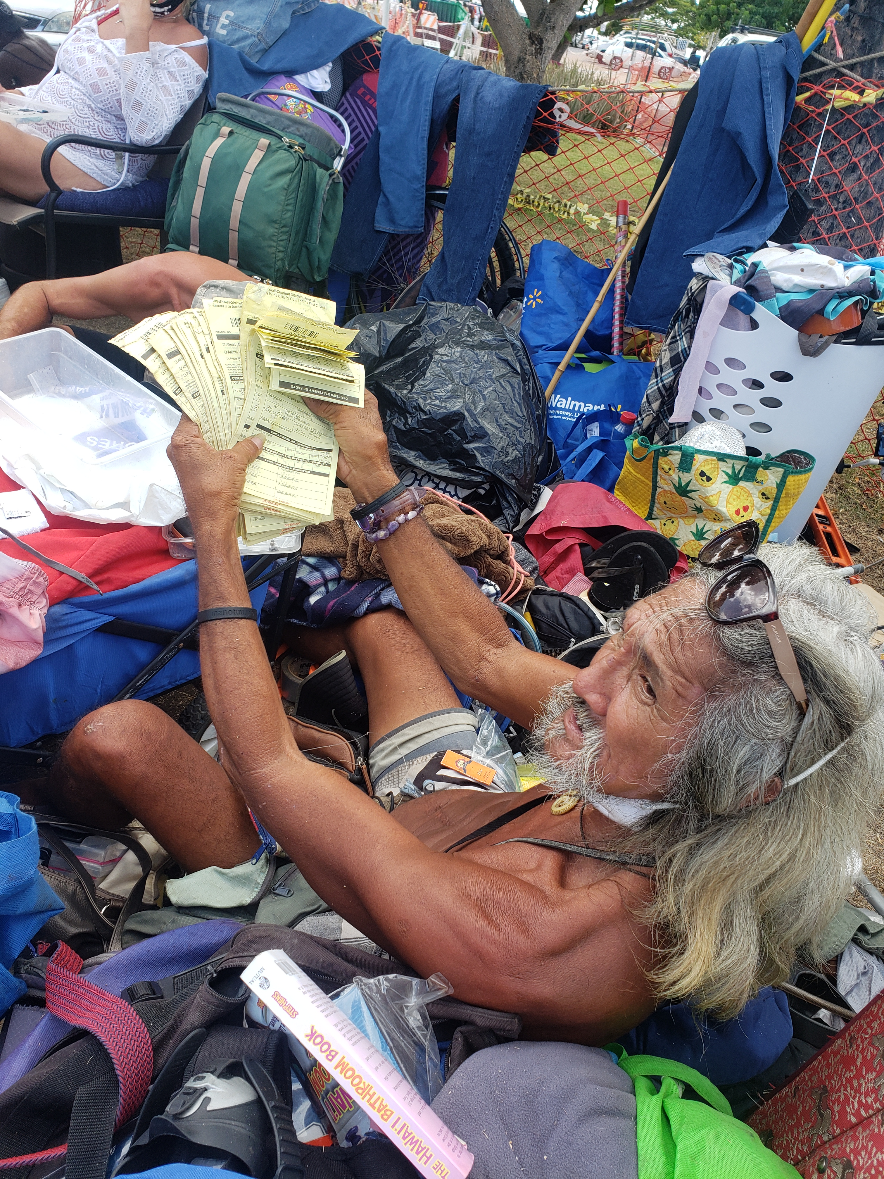
Topic one
Topic two
Topic three
Topic four
Topic five

Slide 5
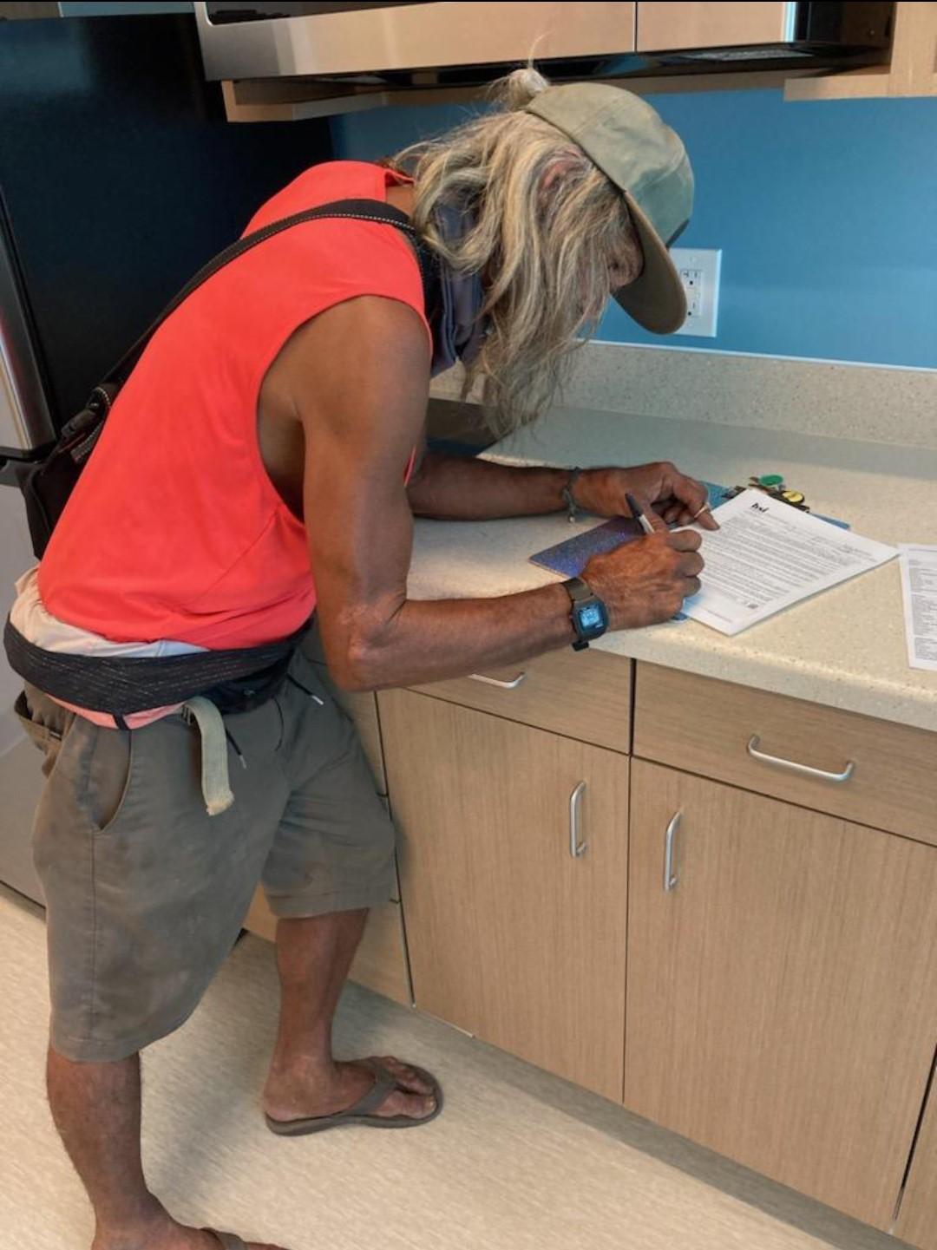
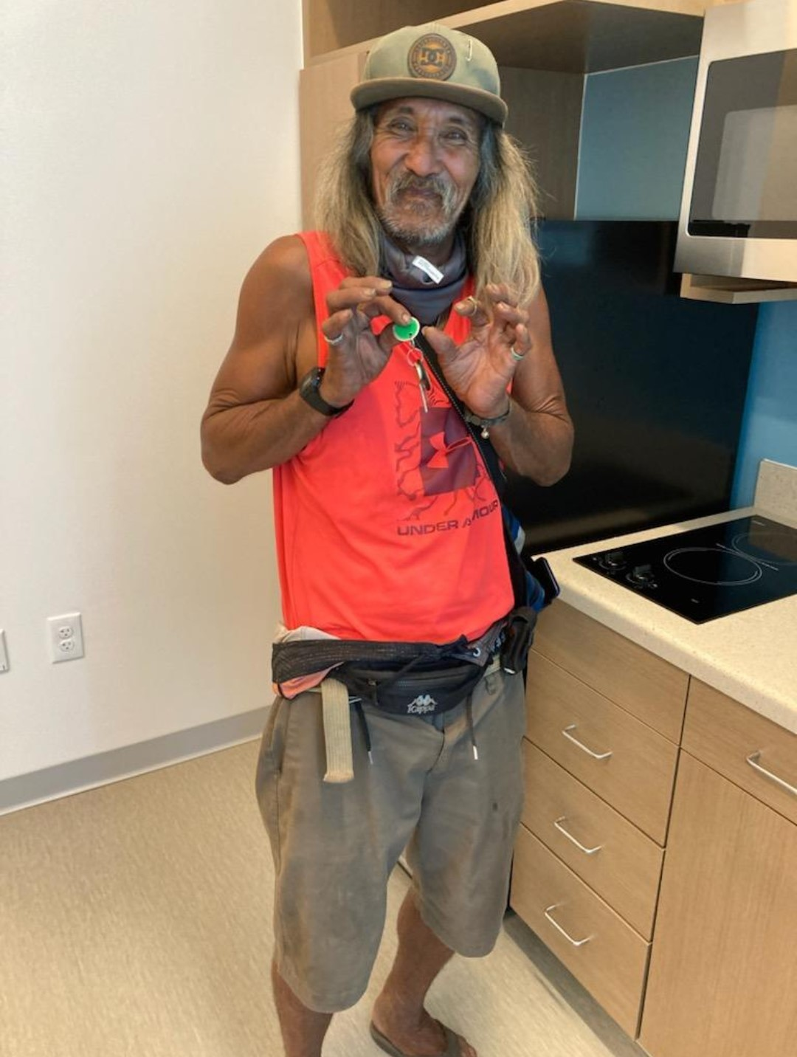
Topic one
Topic two
Topic three
Topic four
Topic five

Slide 6
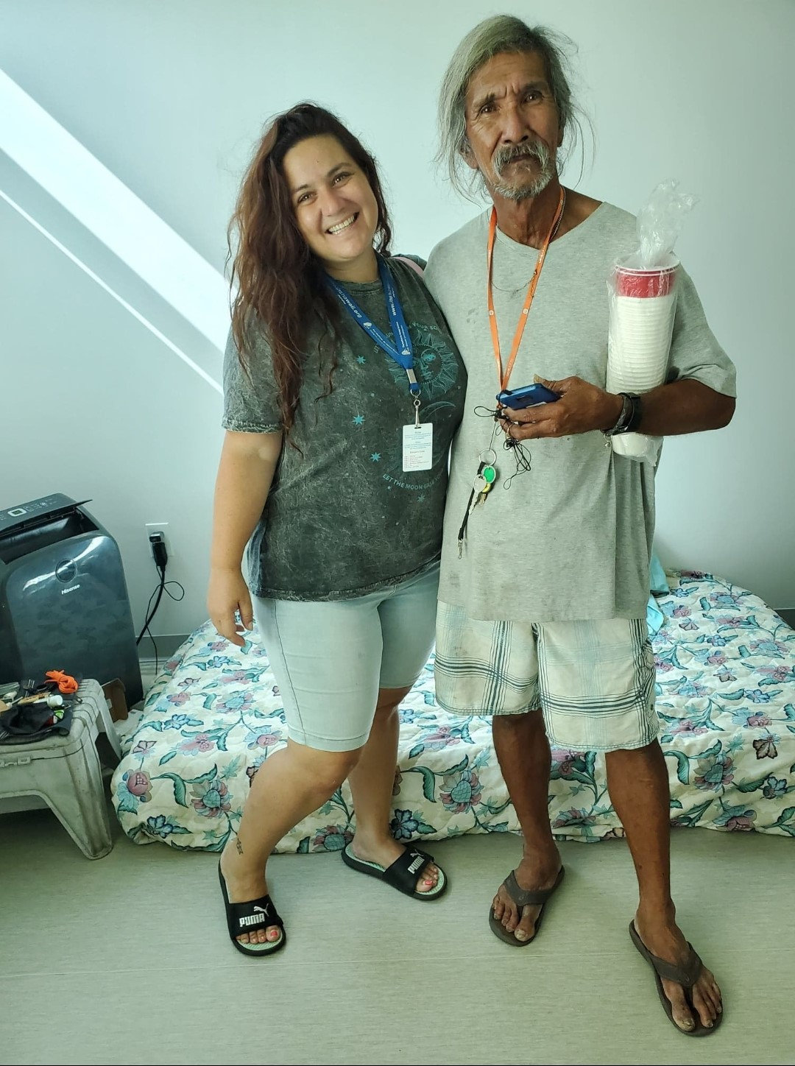
Clarence has been successfully housed for 1 year and 7 months after 23 years of homelessness

Slide 7
Jenny Neal CORE Supervisor/Community Service Specialist

Slide 8
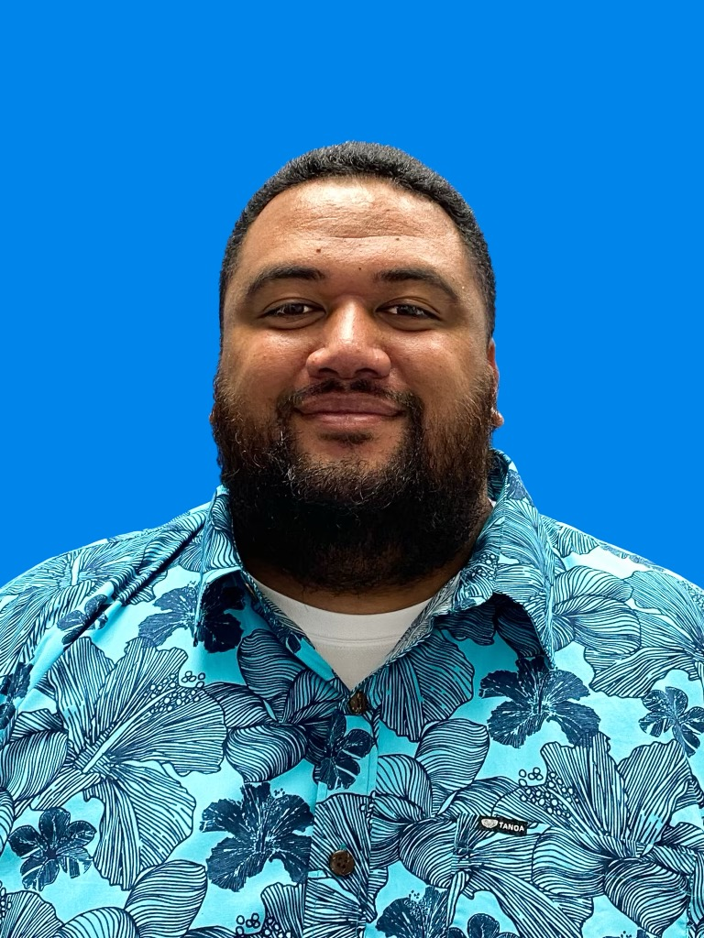
Castro Masaniai Institute of Human Services Outreach Program Manager

Slide 9
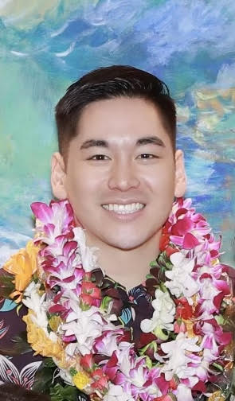
Austin Ajimura HOME Project Director of Onboarding and Patient Advocacy

Slide 10
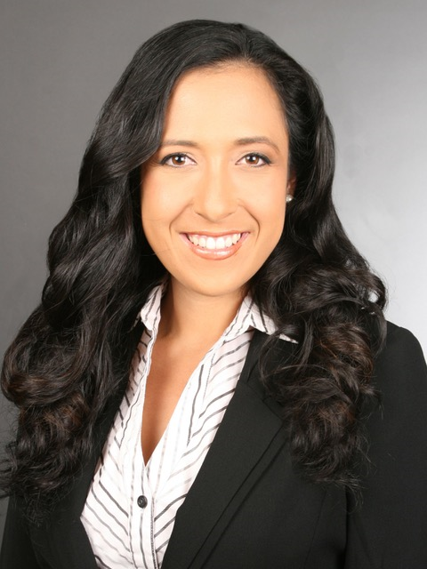
Dr. Teresa Schiff-Elfalan HOME Project Medical Director

Slide 11
Questions and Answers

Slide 12
Thank You

